Slide 1

Software
By: Shelsie Roberts, John Torres, Ifeoluwa Akinrelere, Darrius Weeden

Slide 2
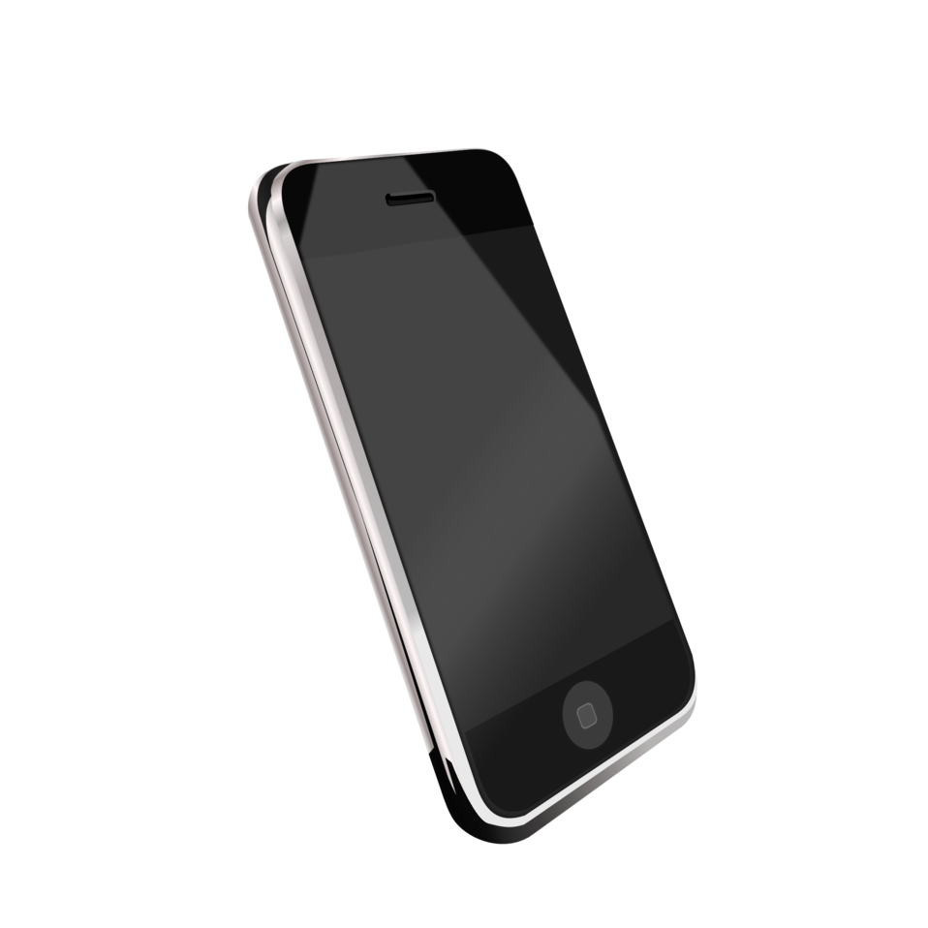
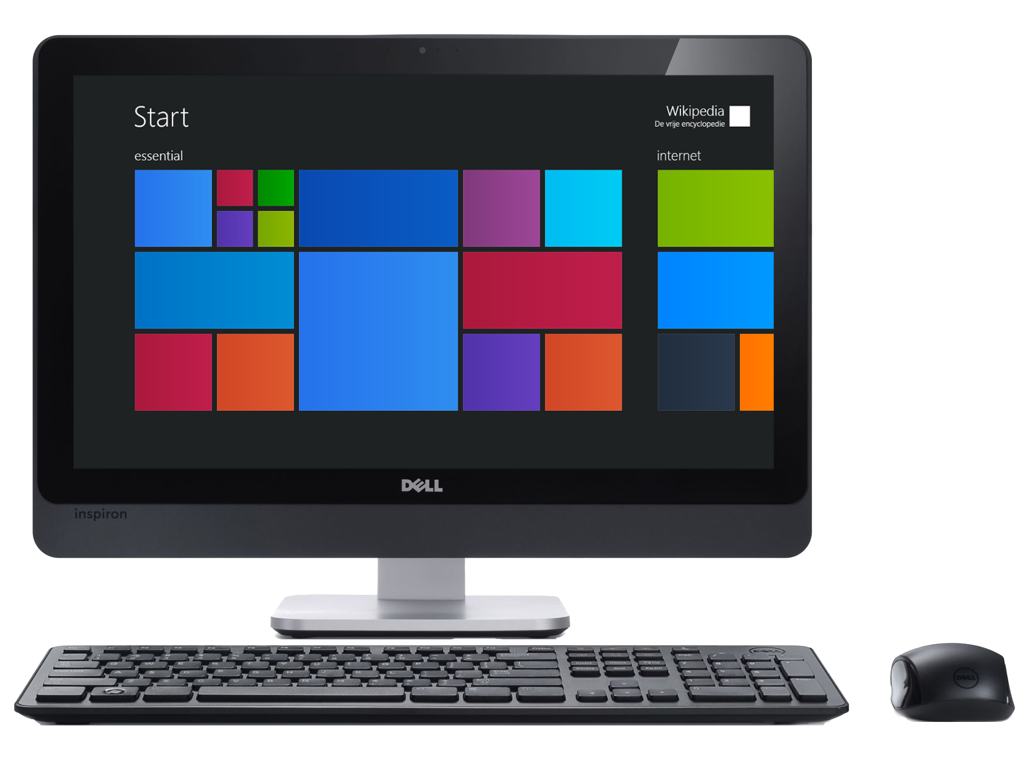
What is Software?
Various kinds of programs used to describe programs that operate on computer devices, this includes tablets, desktop PCs, smartphones, or other devices.

Slide 3
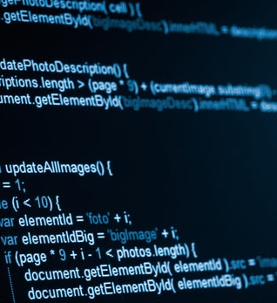

Types of software
System software
Utility software
Application software
Hardware
Programming language software
Middleware
Driver software
Freeware
Open source software
Proprietary software or closed software

Slide 4
When did software emerge?
All computer systems are designed to utilize the "stored program concept" as first developed by Charles Babbage in the 1850s. The concept was lost until the mid-1940s, when modern computers made their appearance.
The very first time a stored-program computer held a piece of software in electronic memory and executed it successfully, was 11 am 21 June 1948, at the University of Manchester, on the Manchester Baby computer. It was written by Tom Kilburn, and calculated the highest factor of the integer 2^18 = 262,144.

Slide 5
Why software are important?
Software is important because…
It can dictate what type of device you’re using.
All economies of developed nations are dependent on software
A lot of systems are software controlled (transportation, medical, military, telecommunications, industrial, and entertainment.

